Slide 1
CHAPTER 20
Introduction to Transaction Processing Concepts and Theory
Probably the second+/last Chapter ☺ before I begin to introduce a small portion of Advanced DBMS - NoSQL

Slide 2
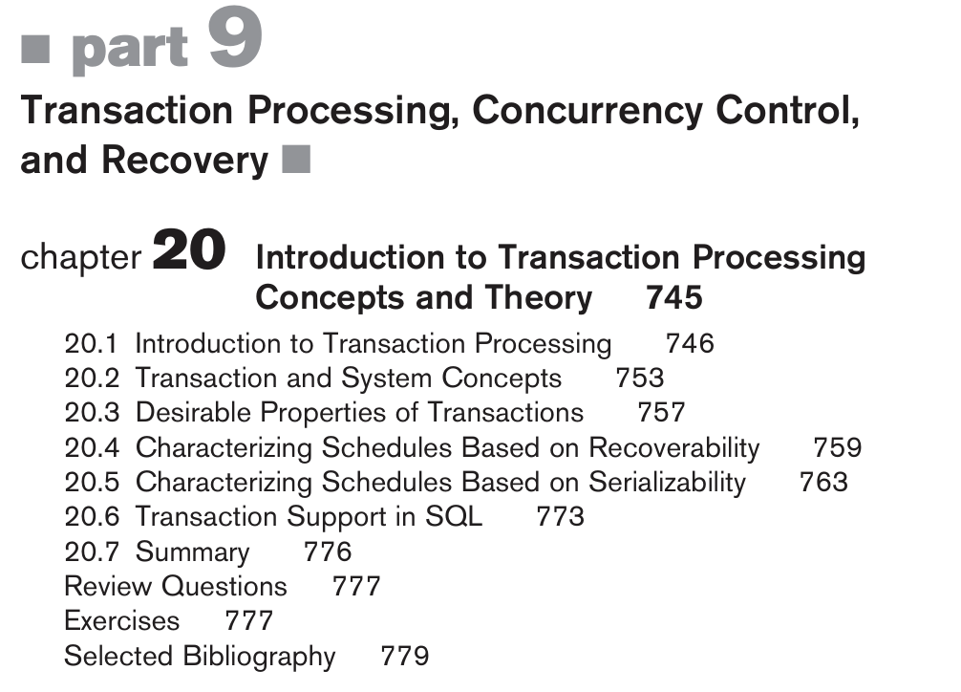
Chapter#20 - Coverage

Slide 3
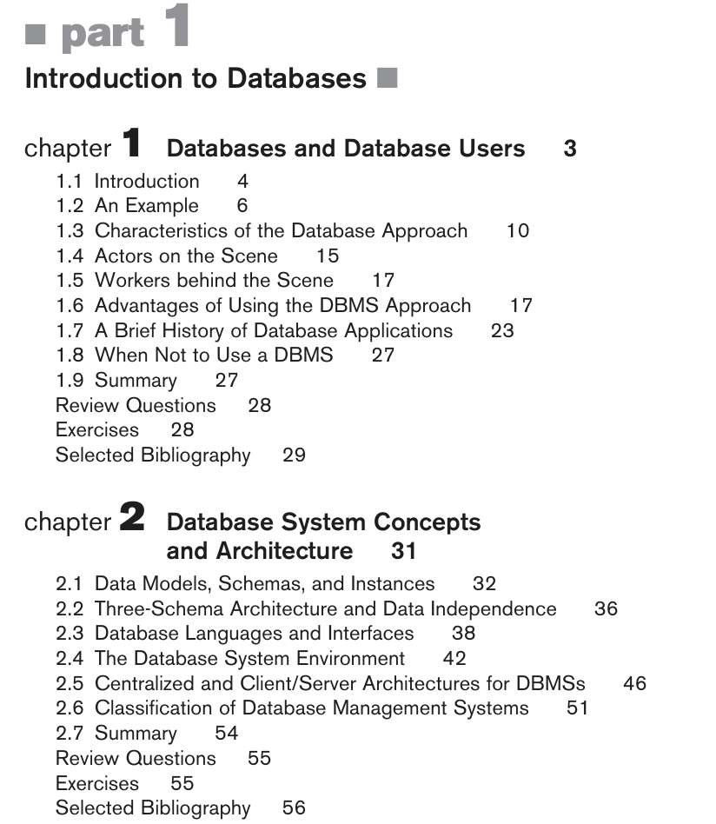
What we have covered so far… EXAM Contents

Slide 4
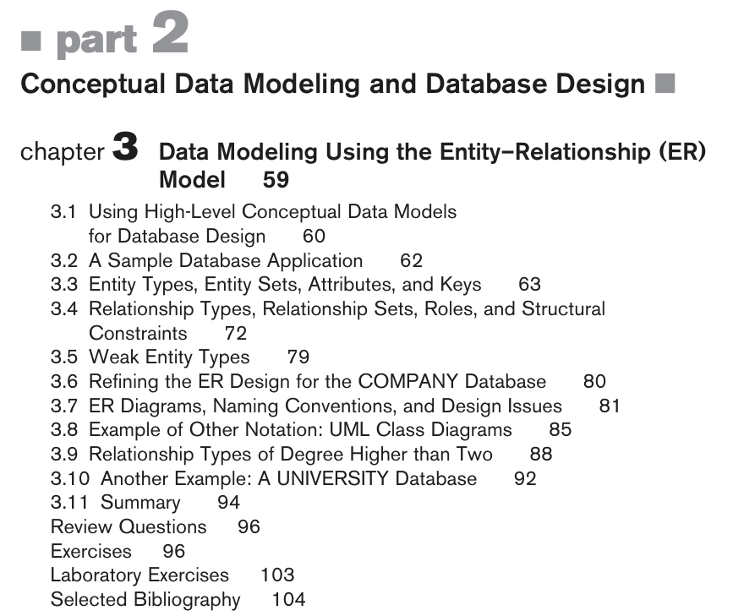
What we have covered so far…

Slide 5
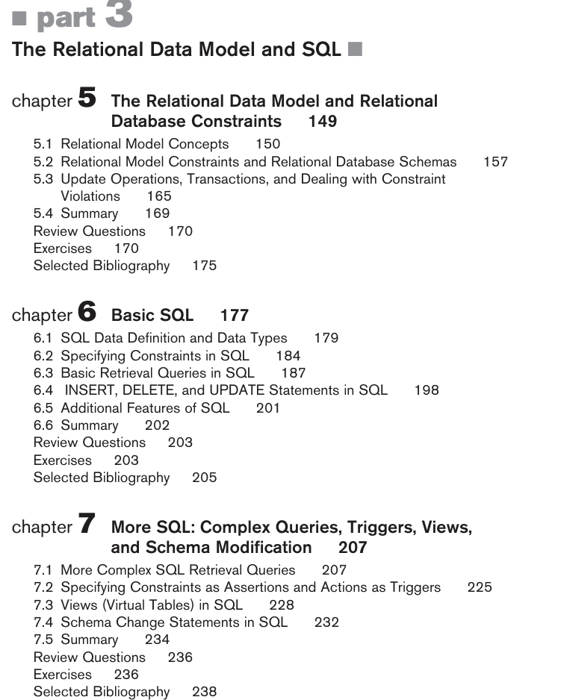
What we have covered so far…

Slide 6
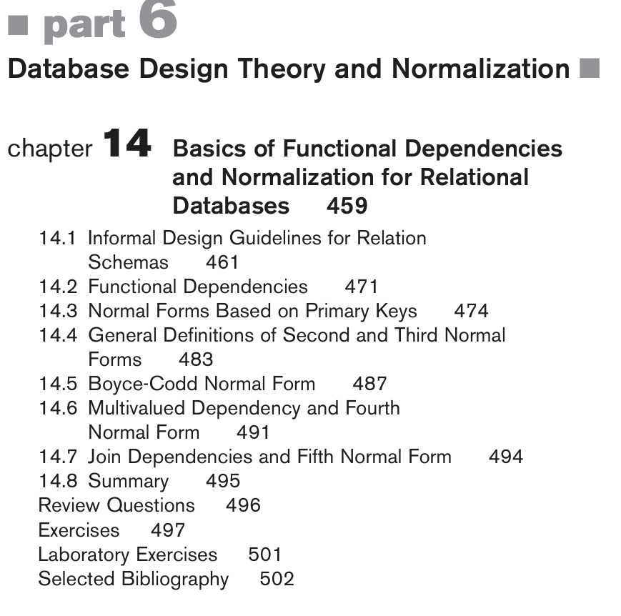
What we have covered so far…

Slide 7
Introduction
Transaction
Describes local unit of database processing
Transaction processing systems
Systems with large databases and hundreds of concurrent users
Require high availability and fast response time
This chapter focuses on the basic concepts and theory that are needed to ensure the correct executions of transactions.

Slide 8
20.1 Introduction to Transaction Processing
Single-user DBMS
At most one user at a time can use the system
Example: home computer
Multiuser DBMS
Many users can access the system (database) concurrently
Example: airline reservations system

Slide 9
20.1 Introduction to Transaction Processing
Multiuser DBMS
Multiple users can access databases—and use computer systems—simultaneously because of the concept of multiprogramming, which allows the operating system of the computer to execute multiple programs—or processes—at the same time.
A process is resumed at the point where it was suspended whenever it gets its turn to use the CPU again.

Slide 10
Introduction to Transaction Processing (cont’d.)
Multiprogramming
Allows operating system to execute multiple processes concurrently
Executes commands from one process, then suspends that process and executes commands from another process, etc.

Slide 11
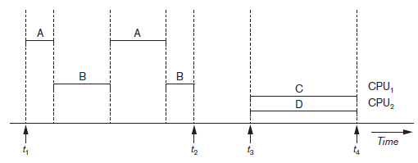
Introduction to Transaction Processing (cont’d.)
Interleaved processing (A,B)
Interleaving keeps the CPU busy when a process requires an input or output (I/O) operation, such as reading a block from disk.
Figure 20.1 Interleaved processing versus parallel processing of concurrent transactions

Slide 12
Introduction to Transaction Processing (cont’d.)
Parallel processing
Processes C and D in figure below
Figure 20.1 Interleaved processing versus parallel processing of concurrent transactions

Slide 13
Interleaved concurrency
The remaining whole chapter depends on this model concept.

Slide 14
ACID Recap
Atomicity: All-or-nothing execution of transactions
Consistency: Ensuring database integrity before and after transactions
Isolation: Transactions operate independently, preventing interference
Durability: Ensuring that completed transactions remain permanent, even in case of a failure

Slide 15
Transactions
Transaction: an executing program
Forms logical unit of database processing
Begin and end transaction statements
Specify transaction boundaries
Read-only transaction
If the database operations in a transaction do not update the database but only retrieve data, the transaction is called a read-only transaction; otherwise it is known as a read-write transaction.
Read-write transaction

Slide 16
Database Items
Database represented as collection of named data items
Size of a data item called its granularity
Data item
Record
Disk block
Attribute value of a record
Transaction processing concepts independent of item granularity
Notes:
noun
the quality or condition of being granular.
technical
the scale or level of detail present in a set of data or other phenomenon:
"the bill data doesn't provide sufficient granularity to answer the questions"

Slide 17
Granularity
Granularity in a (DBMS) refers to the level of detail or precision at which data can be accessed or manipulated.
It affects how data is stored, queried, and managed, impacting performance, storage efficiency, and transaction management.
Higher granularity implies more detailed data, which can lead to increased complexity, while lower granularity may simplify data handling but might reduce the detail accessible.

Slide 18
Read and Write Operations
read_item(X)
Reads a database item named X into a program variable named X
Process includes finding the address of the disk block, and copying to and from a memory buffer
write_item(X)
Writes the value of program variable X into the database item named X
Process includes finding the address of the disk block, copying to and from a memory buffer, and storing the updated disk block back to disk

Slide 19
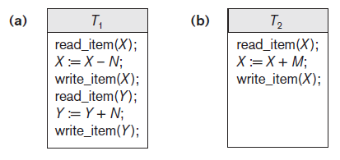
Read and Write Operations (cont’d.)
Read set of a transaction
Set of all items read
Write set of a transaction
Set of all items written
Figure 20.2 Two sample transactions (a) Transaction T1 (b) Transaction T2

Slide 20
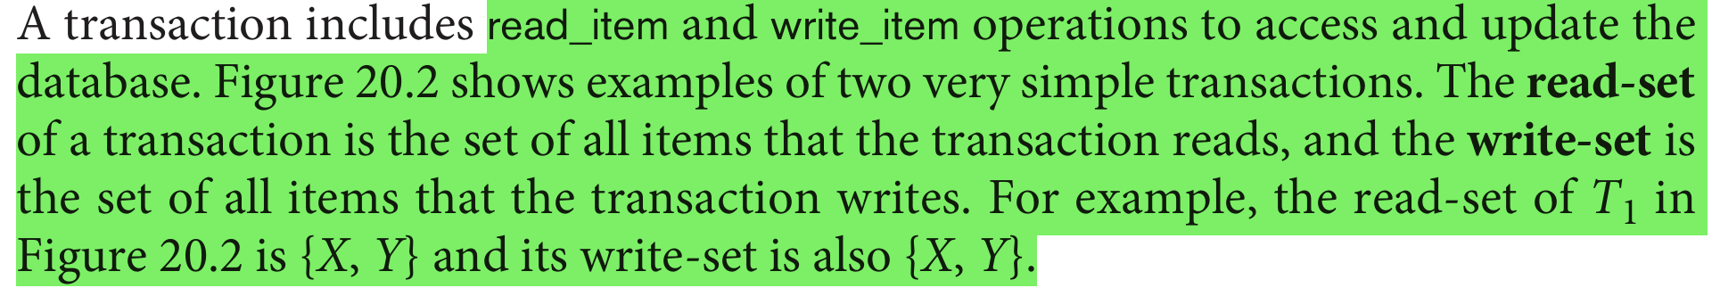

Slide 21
DBMS Buffers
DBMS will maintain several main memory data buffers in the database cache
When buffers are occupied, a buffer replacement policy is used to choose which buffer will be replaced
Example policy: least recently used (LRU)

Slide 22
Concurrency Control - Why it is needed
Transactions submitted by various users may execute concurrently
Access and update the same database items
Some form of concurrency control is needed
The lost update problem
Occurs when two transactions that access the same database items have operations interleaved
Results in incorrect value of some database items

Slide 23
Example of the Lost Update Problem
Consider two transactions, T1 and T2, that both access and update the same bank account balance.
Initial Balance: $1000
Transaction T1
Reads the balance: Balance = $1000
Calculates a new balance: New Balance = $1000 - $100 (withdrawal) = $900
Updates the balance to $900.
Transaction T2
Reads the balance: Balance = $1000 (since T1 has not yet committed)
Calculates a new balance: New Balance = $1000 + $200 (deposit) = $1200
Updates the balance to $1200.

Slide 24
Example of the Lost Update Problem
Interleaving Operations
Assuming the operations are interleaved as follows:
T1 starts and reads the balance ($1000).
T2 starts and reads the same balance ($1000).
T1 computes the new balance ($900) and writes it back.
T2 computes its new balance ($1200) and writes it back.
Final State
After both transactions complete, the final balance in the account is $1200. However, the withdrawal made by T1 is lost because T2's update overwrote T1's result.

Slide 25
Example of the Lost Update Problem
Consequences
Data Integrity Issues: The updates from T1 are lost, leading to incorrect data in the database.
Potential Errors: This can cause serious errors in applications, especially in financial systems.
Prevention
To prevent the lost update problem, concurrency control mechanisms can be employed, such as:
Locking: Ensuring that when one transaction is reading or writing to a database item, no other transaction can access it until the first transaction is complete.
Isolation Levels: Using appropriate isolation levels (like Serializable) to control the visibility of changes made by concurrent transactions.

Slide 26
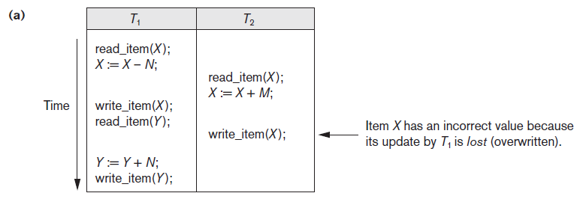
The Lost Update Problem
X = 80
N=5
X = 80
M = 4
the final result should be X = 79,
But it is X = 84
Figure 20.3 Some problems that occur when concurrent execution is uncontrolled (a) The lost update problem

Slide 27
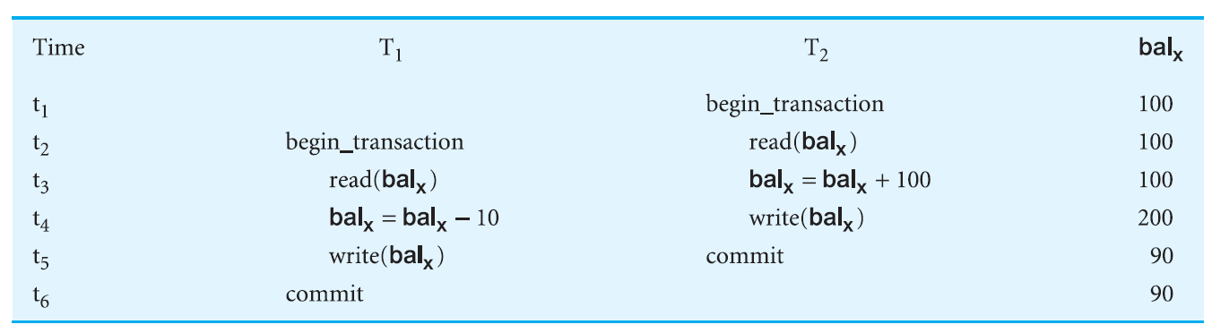
The Lost Update Problem
Figure 20.3 Some problems that occur when concurrent execution is uncontrolled (a) The lost update problem

Slide 28
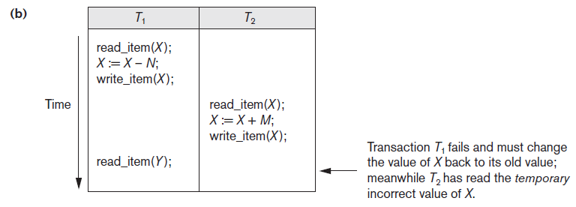
The Temporary Update Problem OR Dirty Read Problem OR Uncommitted Dependency Problem
Figure 20.3 (cont’d.) Some problems that occur when concurrent execution is uncontrolled (b) The temporary update problem

Slide 29
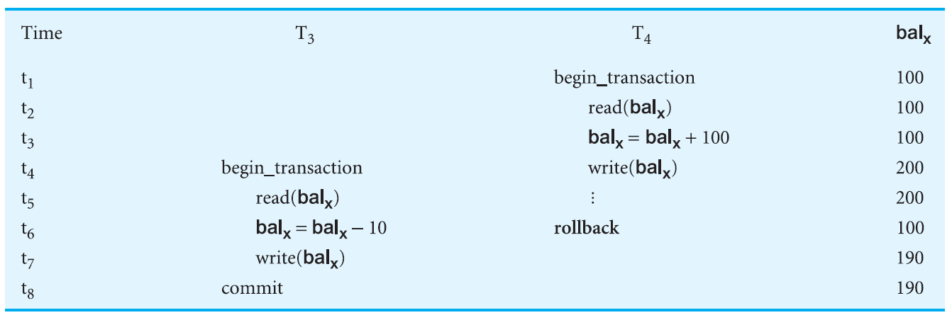
The Temporary Update Problem OR Dirty Read Problem OR Uncommitted Dependency Problem
Figure 20.3 (cont’d.) Some problems that occur when concurrent execution is uncontrolled (b) The temporary update problem

Slide 30
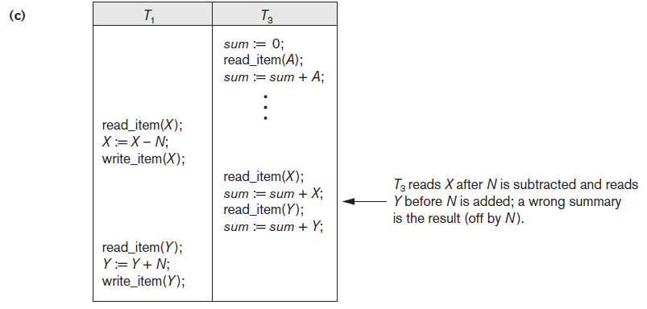
The Incorrect Summary Problem
Figure 20.3 (cont’d.) Some problems that occur when concurrent execution is uncontrolled (c) The incorrect summary problem

Slide 31
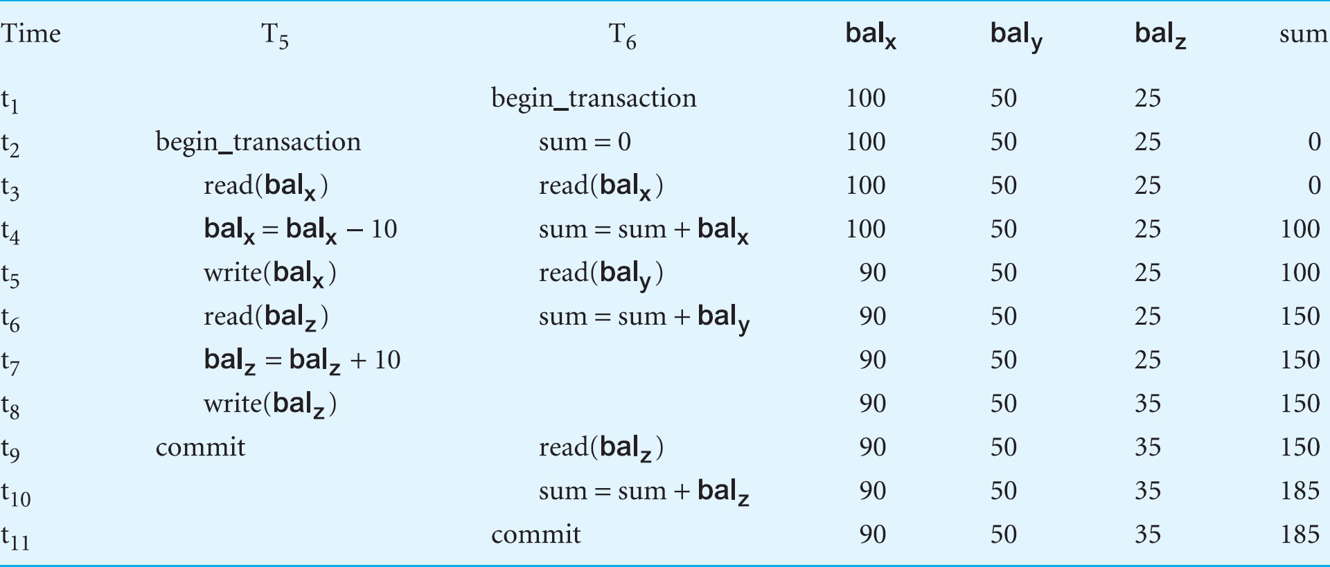
The Incorrect Summary Problem OR Inconsistent Analysis Problem
Figure 20.3 (cont’d.) Some problems that occur when concurrent execution is uncontrolled (c) The incorrect summary problem

Slide 32
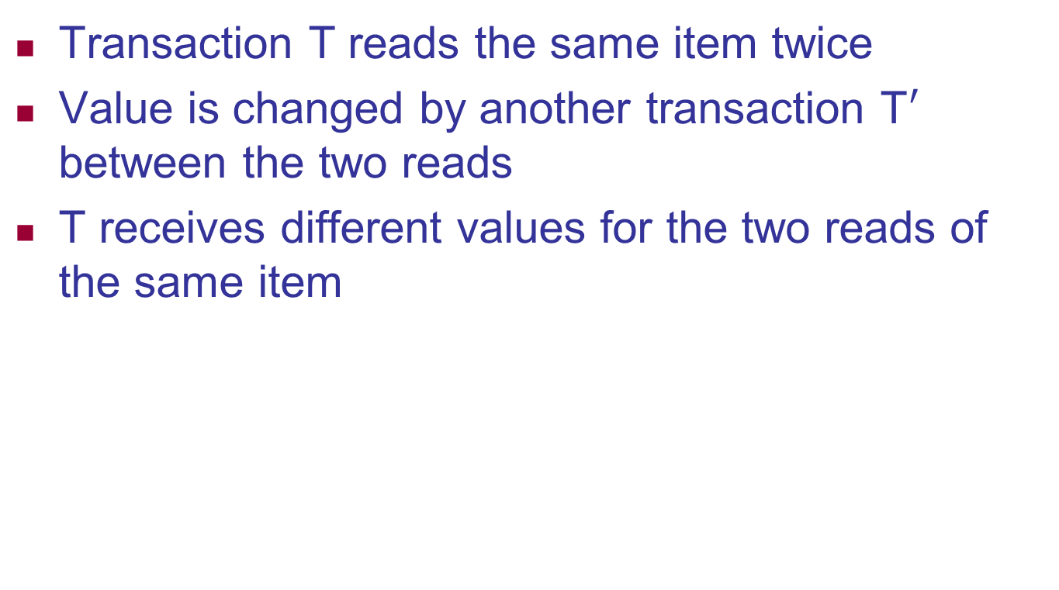
The Unrepeatable Read Problem (Fuzzy Read)
Transaction T reads the same item twice
Value is changed by another transaction T$′$ between the two reads
T receives different values for the two reads of the same item

Slide 33
The Phantom Read Problem
Transaction T executes a query that retrieves a set of tuples from a relation satisfying a certain predicate
T re-executes the query at a later time, but finds that the retrieved set contains an additional (phantom) that has been inserted by another transaction in the meantime.
T receives different tuples for the same query

Slide 34
Why Recovery is Needed
Committed transaction
Effect recorded permanently in the database
Aborted transaction
Does not affect the database
Types of transaction failures
Computer failure (system crash)
Transaction or system error
Local errors or exception conditions detected by the transaction

Slide 35
Why Recovery is Needed (cont’d.)
Types of transaction failures (cont’d.)
Concurrency control enforcement
Disk failure
Physical problems or catastrophes
System must keep sufficient information to recover quickly from the failure
Disk failure or other catastrophes have long recovery times

Slide 36
Next lecture

Slide 37
20.2 Transaction and System Concepts
System must keep track of when each transaction starts, terminates, commits, and/or aborts
BEGIN_TRANSACTION
READ or WRITE
END_TRANSACTION
COMMIT_TRANSACTION
ROLLBACK (or ABORT)

Slide 38
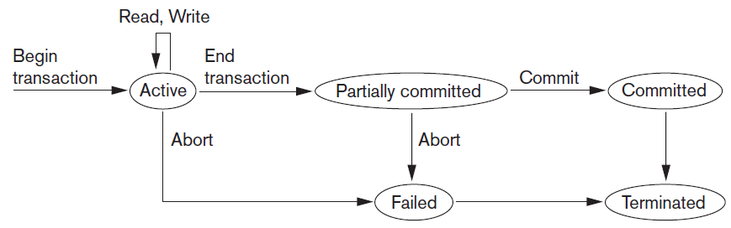
Transaction and System Concepts (cont’d.)
Figure 20.4 State transition diagram illustrating the states for transaction execution

Slide 39
The System Log
System log keeps track of transaction operations
Sequential, append-only file
Not affected by failure (except disk or catastrophic failure)
Log buffer
Main memory buffer
When full, appended to end of log file on disk
Log file is backed up periodically
Undo and redo operations based on log possible

Slide 40
Commit Point of a Transaction
Occurs when all operations that access the database have completed successfully
And effect of operations recorded in the log
Transaction writes a commit record into the log
If system failure occurs, can search for transactions with recorded start_transaction but no commit record
Force-writing the log buffer to disk
Writing log buffer to disk before transaction reaches commit point

Slide 41
DBMS-Specific Buffer Replacement Policies
Page replacement policy
Selects particular buffers to be replaced when all are full
Domain separation (DS) method
Each domain handles one type of disk pages
Index pages
Data file pages
Log file pages
Number of available buffers for each domain is predetermined

Slide 42
DBMS-Specific Buffer Replacement Policies (cont’d.)
Hot set method
Useful in queries that scan a set of pages repeatedly
Does not replace the set in the buffers until processing is completed
The DBMIN method
Predetermines the pattern of page references for each algorithm for a particular type of database operation
some queries may reference the same file twice, so there would be a locality set for each file instance needed in the query
Calculates locality set using Query Locality Set Model (QLSM)

Slide 43
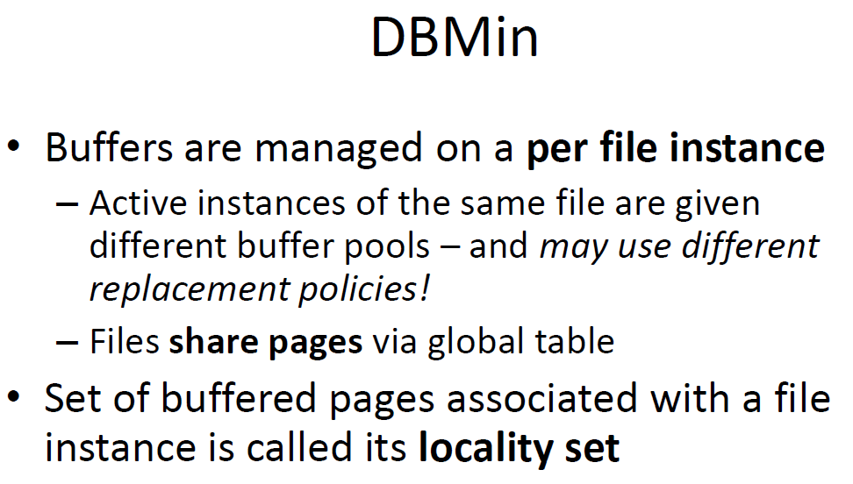
DBMS-Specific Buffer Replacement Policies (cont’d.)

Slide 44
20.3 Desirable Properties of Transactions
ACID properties
Atomicity
Transaction performed in its entirety or not at all
Consistency preservation
Takes database from one consistent state to another
Isolation
Not interfered with by other transactions
Durability or permanency
Changes must persist in the database

Slide 45
Desirable Properties of Transactions (cont’d.)
Levels of isolation
Level 0 isolation does not overwrite the dirty reads of higher-level transactions
Level 1 isolation has no lost updates
Level 2 isolation has no lost updates and no dirty reads
Level 3 (true) isolation has repeatable reads
In addition to level 2 properties
Snapshot isolation
transaction sees the data items that it reads based on the committed values of the items in the database snapshot (or database state) when the transaction starts. Snapshot isolation will ensure that the phantom record problem does not occur

Slide 46
20.4 Characterizing Schedules Based on Recoverability
Schedule or history
Order of execution of operations from all transactions
Operations from different transactions can be interleaved in the schedule
Total ordering of operations in a schedule
For any two operations in the schedule, one must occur before the other

Slide 47
Some Definitions
Schedule
A sequence of the operations by a set of concurrent transactions that preserves the order of the operations in each of the individual transactions.
Serial Schedule
A schedule where the operations of each transaction are executed consecutively without any interleaved operations from other transactions.
Non-serial Schedule
A schedule where the operations from a set of concurrent transactions are interleaved.
Serializability
find non-serial schedules that allow transactions to execute concurrently without interfering with one another, and thereby produce a database state that could be produced by a serial execution.

Slide 48
i.e. (in essence)
If a set of transactions executes concurrently,
We say that the (non-serial) schedule is correct
If it produces the same result as some serial execution.
Such a schedule is called serializable.
To prevent inconsistency from transactions interfering with one another… it is essential to guarantee serializability of concurrent transactions.

Slide 49
Characterizing Schedules Based on Recoverability (cont’d.)
Two conflicting operations in a schedule
Operations belong to different transactions
Operations access the same item X
At least one of the operations is a write_item(X)
Two operations conflict if changing their order results in a different outcome
Read-write conflict
Write-write conflict

Slide 50
Characterizing Schedules Based on Recoverability (cont’d.)
Recoverable schedules
Recovery is possible
Nonrecoverable schedules should not be permitted by the DBMS
No committed transaction ever needs to be rolled back
Cascading rollback is a situation: where an uncommitted transaction has to be rolled back because it read an item from a transaction that failed.
Cascading rollback may occur in some recoverable schedules

Slide 51
Characterizing Schedules Based on Recoverability (cont’d.)
Cascadeless schedule
Avoids cascading rollback
Strict schedule
Transactions can neither read nor write an item X until the last transaction that wrote X has committed or aborted
Simpler recovery process
Restore the before image

Slide 52
20.5 Characterizing Schedules Based on Serializability
Serializable schedules
Always considered to be correct when concurrent transactions are executing
Places simultaneous transactions in series
Transaction T₁ before T₂, or vice versa

Slide 53
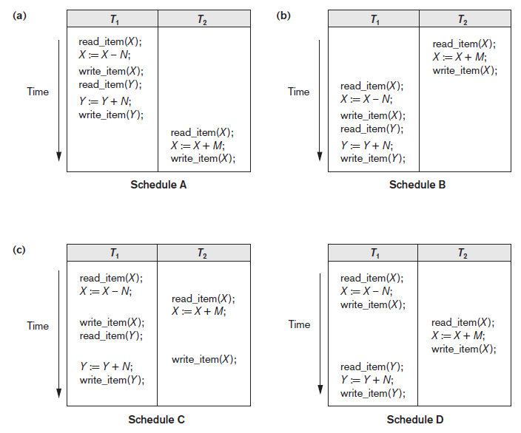
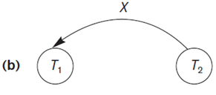
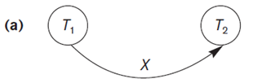
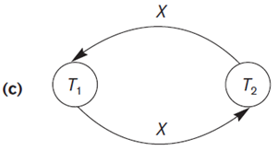
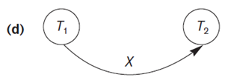
Figure 20.5 Examples of serial and nonserial schedules involving transactions T1 and T2 (a) Serial schedule A: T1 followed by T2 (b) Serial schedule B: T2 followed by T1 (c) Two nonserial schedules C and D with interleaving of operations

Slide 54
Characterizing Schedules Based on Serializability (cont’d.)
Problem with serial schedules
Limit concurrency by prohibiting interleaving of operations
Unacceptable in practice
Solution: determine which schedules are equivalent to a serial schedule and allow those to occur
Serializable schedule of n transactions
Equivalent to some serial schedule of same n transactions

Slide 55
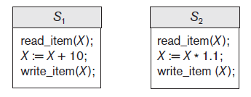
Characterizing Schedules Based on Serializability (cont’d.)
Result equivalent schedules
Produce the same final state of the database
May be accidental
Cannot be used alone to define equivalence of schedules
They execute different transactions
Figure 20.6 Two schedules that are result equivalent for the initial value of X = 100 but are not result equivalent in general

Slide 56
Characterizing Schedules Based on Serializability (cont’d.)
Conflict equivalence
Relative order of any two conflicting operations is the same in both schedules
Serializable schedules (Called conflict serializable)
Schedule S is serializable if it is conflict equivalent to some serial schedule S’.

Slide 57
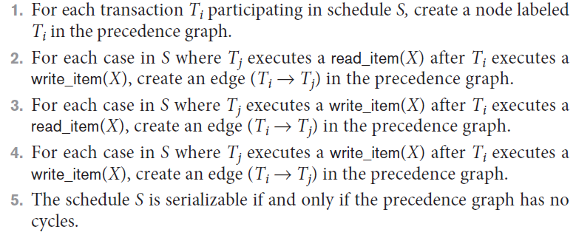
Characterizing Schedules Based on Serializability (cont’d.)
Testing for serializability of a schedule
Algorithm 20.1 Testing conflict serializability of a schedule S

Slide 58
Figure 20.7 Constructing the precedence graphs for schedules A to D from Figure 20.5 to test for conflict serializability (a) Precedence graph for serial schedule A (b) Precedence graph for serial schedule B (c) Precedence graph for schedule C (not serializable) (d) Precedence graph for schedule D (serializable, equivalent to schedule A)

Slide 59
How Serializability is Used for Concurrency Control
Being serializable is different from being serial
Serializable schedule gives benefit of concurrent execution
Without giving up any correctness
Difficult to test for serializability in practice
Factors such as system load, time of transaction submission, and process priority affect ordering of operations
DBMS enforces protocols
Set of rules to ensure serializability

Slide 60
View Equivalence and View Serializability
View equivalence of two schedules
As long as each read operation of a transaction reads the result of the same write operation in both schedules, the write operations of each transaction must produce the same results
Read operations said to see the same view in both schedules
View serializable schedule
View equivalent to a serial schedule

Slide 61
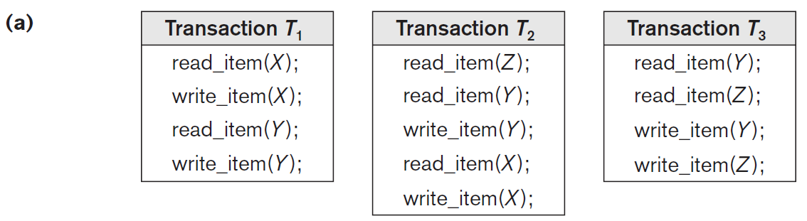
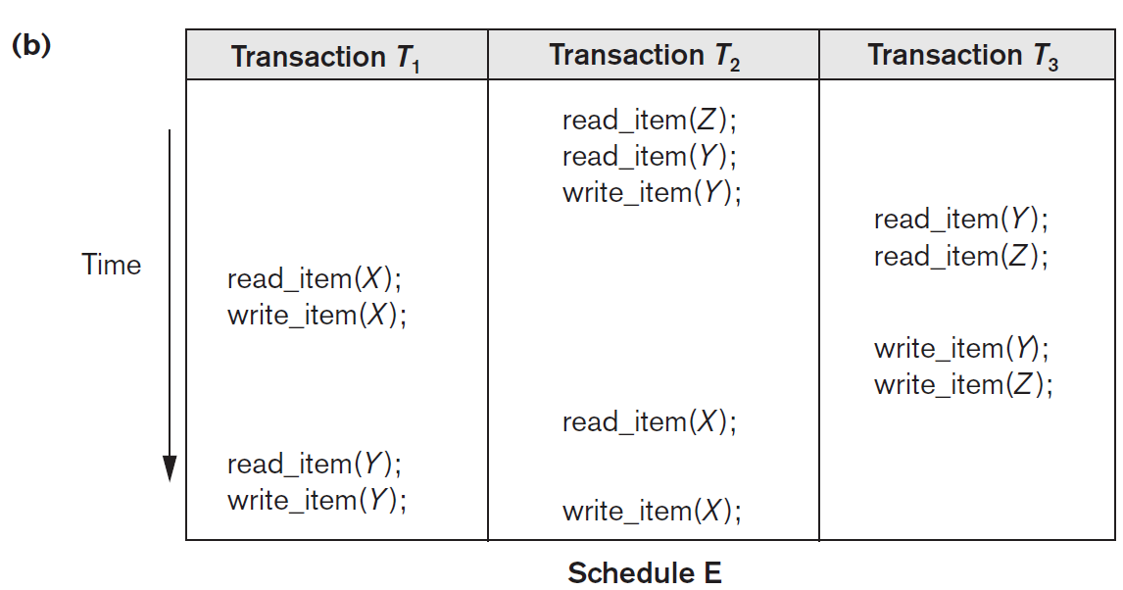
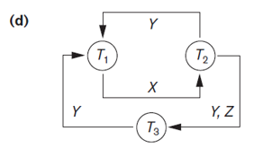

Slide 62
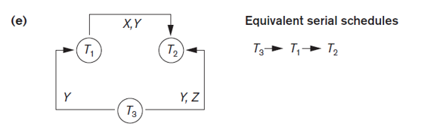
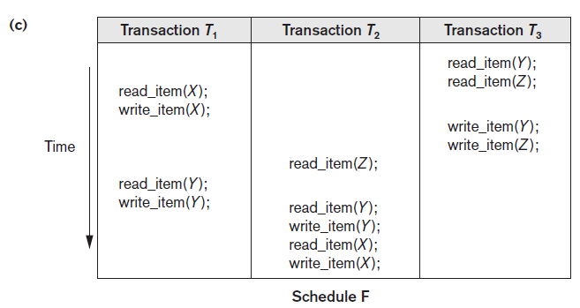

Slide 63
